Slide 1
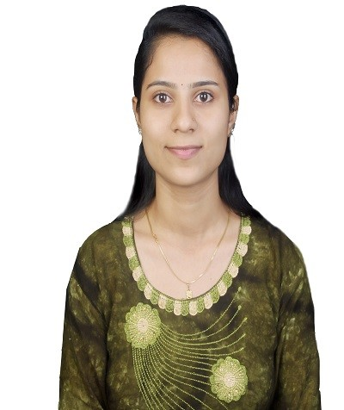
Profile: Salesforce Developer
Salesforce Developer
NAME: MANASI VINOD KALYANKAR
PROFILE SUMMARY
More than 9 months of experience in Software designing & developing CRM (Sales, Service & Marketing) in Salesforce.com and Force.com . Involved in design, development ,test and implementation phases of Software Development Life Cycle and Agile Development with focus in Object Oriented Programming.
TECHNICAL SKILL SET
Sales Configuration
Role, Users and Profile Creation
Security handling – Object level, Record (OWD) and Field level
Data validation
Data modeling
Configure user interface
App creation with logo fixing
License management
Customization of tabs
LWC Framework
HTML , CSS , JS for LWC
Apex Classes and Apex Triggers
SOQL
Done Unit Testing
EDUCATION & PROFESSIONAL CERTIFICATIONS
B.E From KLS Gogte Institute Of Technology ,Belagavi,Karnataka
Salesforce Certified Administrator
Salesforce Certified Platform Developer I

